Slide 1
Literature Review

Slide 2
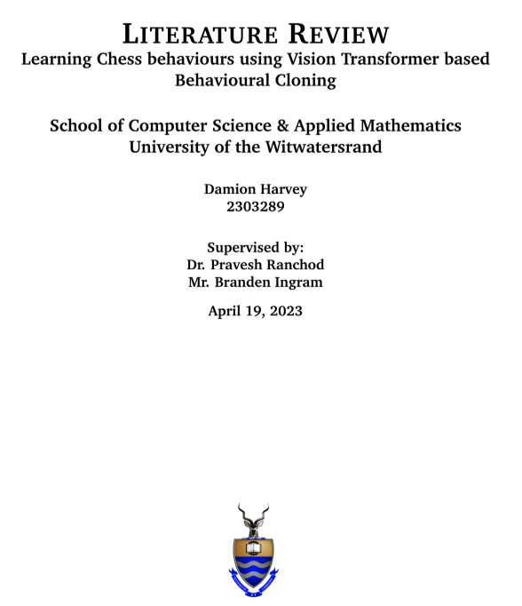
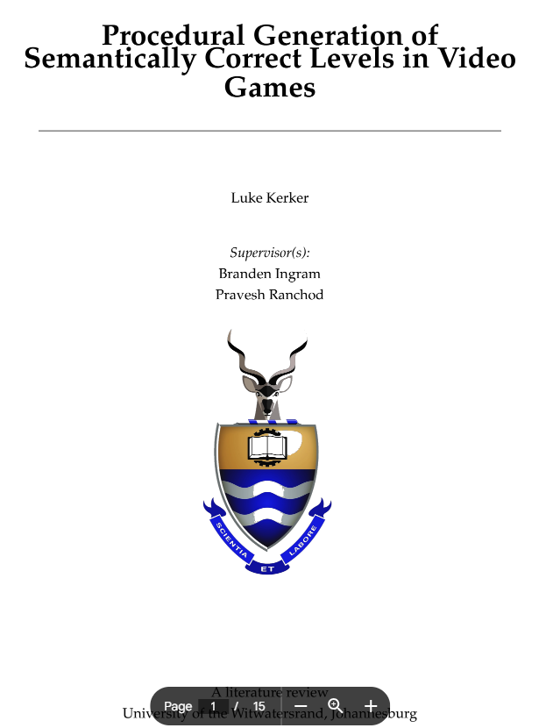
Introduction

Slide 3
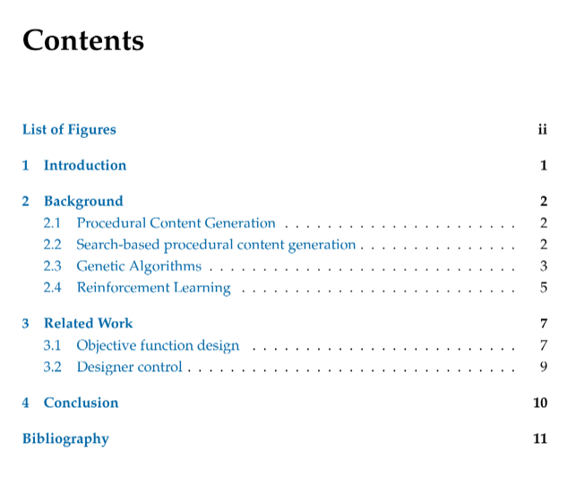
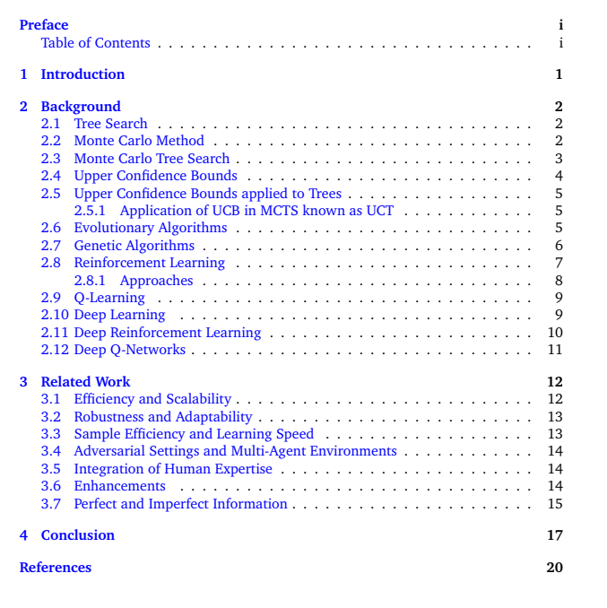
Structure

Slide 4
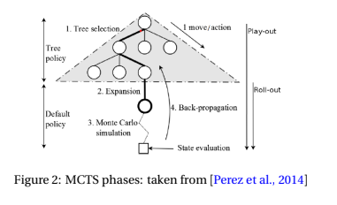
Presentation
Figures need to be clear / large / not pixelated

Slide 5
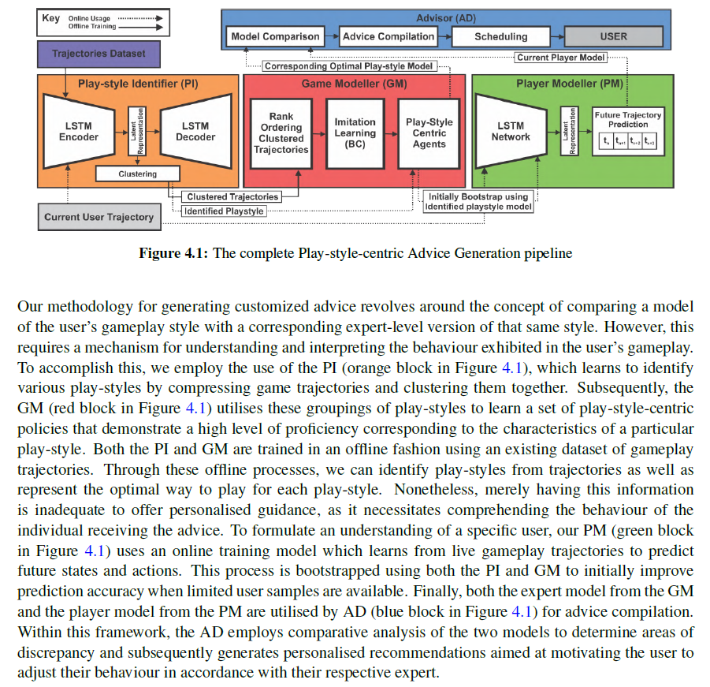
Presentation
Figures need to referenced from the text
Reference part of the figure if needed

Slide 6
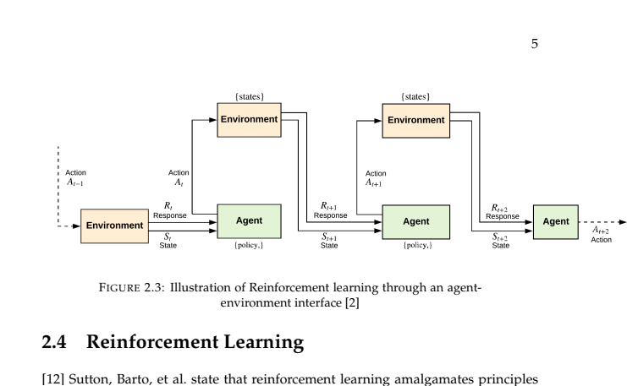
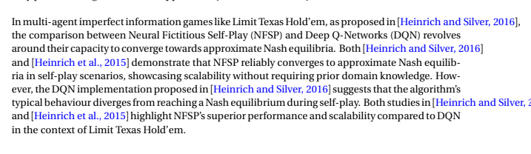
Presentation
Tables/Figures/Algorithms/Text need to obey margins

Slide 7
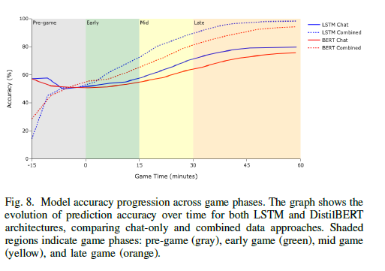
Presentation
No text even inside a Figure can be smaller than a default caption

Slide 8



Presentation
Use correct apostrophe
`` ‘‘

Slide 9
Citations
\citep
\citet
\citep{A,B}
Cite your Figures as well, unless you made it

Slide 10
Citations
Be more trigger happy when it comes to citations
Cite the seminal works when introducing concepts

Slide 11
Writing Style
Present Tense
The authors argue that
The authors present
The authors demonstrate
The authors show
Temporal Wording
More recently,
Modern techniques,

Slide 12
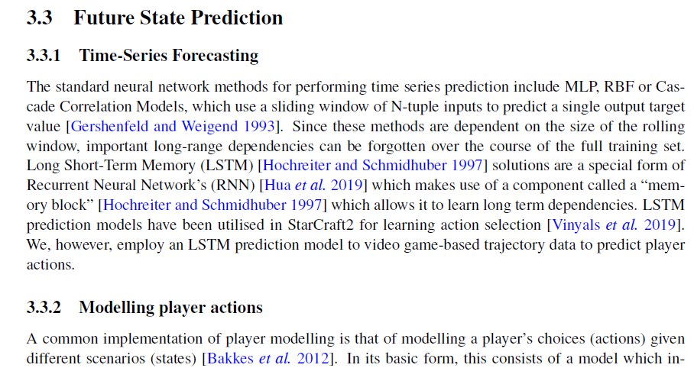
Writing Style
Connective Phrasing

Slide 13
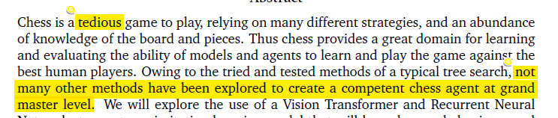
Writing Style
Precise statement of fact

Slide 14
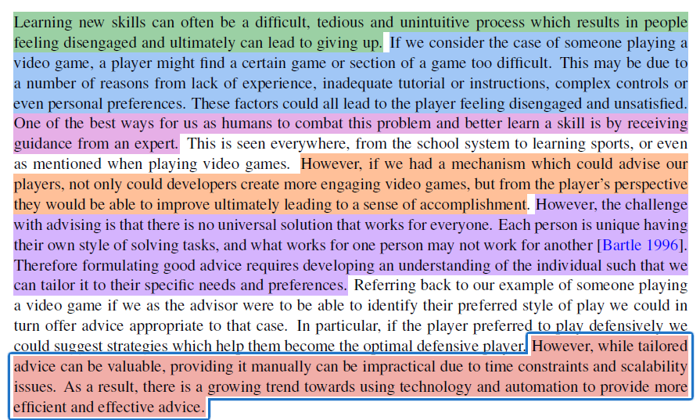
Introduction Section
General Problem
Easy to understand example
Conceptual Solution leading to specific Problem
Why it is interesting
Why it is difficult
Specific Solution

Slide 15
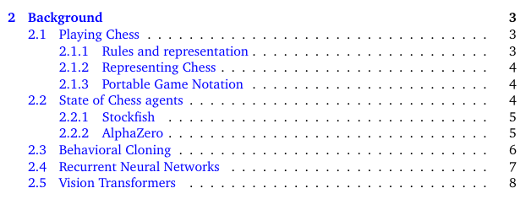
Background Section
The background section should teach me the specifics of how a thing works

Slide 16
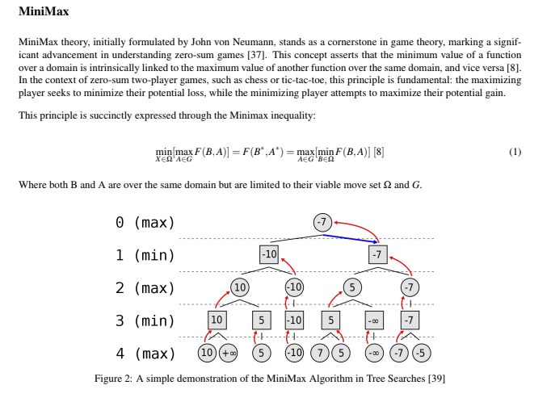
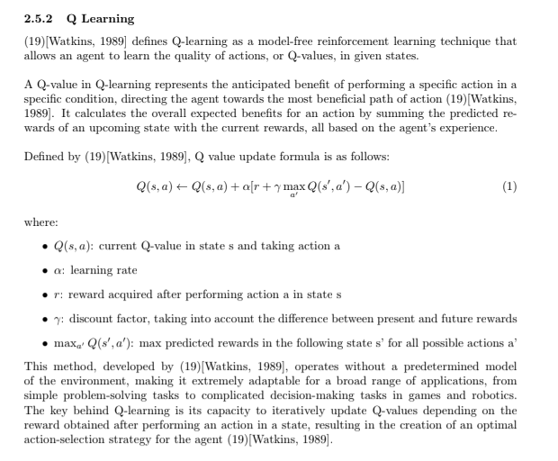
Background Section
Mathematically precise
How do models learn/update
What data structures are needed

Slide 17
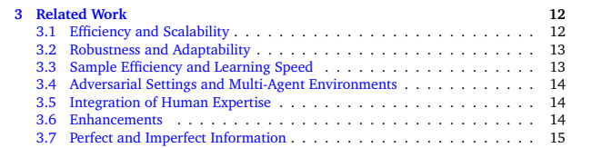
Related Work Section
Here you need to identify what are the important themes that make up the relevant work

Slide 18
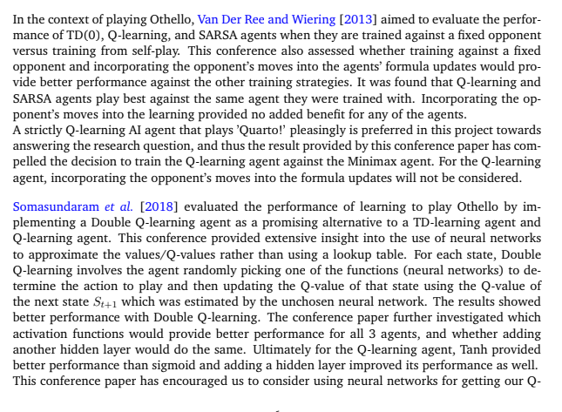
Related Work Section
Not a summary

Slide 19
Related Work Section
Needs to flow like a story with natural progression
so one storyline could be as follows; chess is a hard game -> initially Y researchers used X and Z techniques to create a chess bot, however they were limited because of P -> along came R who used another approach to overcome this -> we also use this by adapting it ... -> another problem in chess is L -> Q researchers in field J have applied T in a similar domain -> we leverage this by .

Slide 20
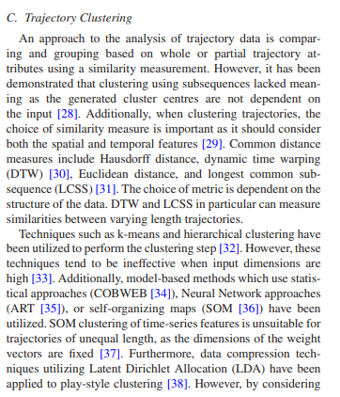
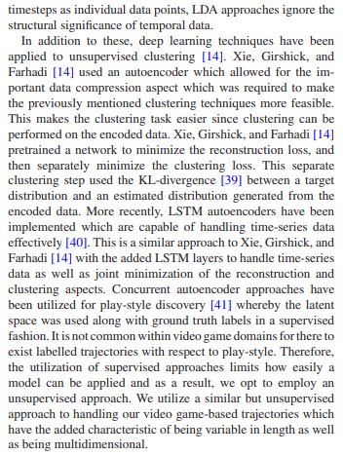
Related Work Section

